Slide 1
CT &DT –SPSU-"ANONYMOUS"- TASK#09
STAKEHOLDER MAPPING FOR THE COLD STORAGE FACILITY ESTABLISHMENT

Slide 2
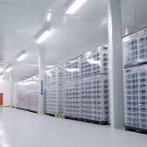
Cold Storage Facility Establishment
A stakeholder mapping for the establishment of a cold storage facility can help identify the various individuals, groups and organizations involved or affected by the project. Stakeholders can be categorized based on their influence, interest and power regarding the project. Here's a stakeholder map broken down by category:

Slide 3
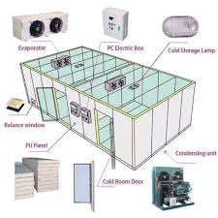
Internal Stakeholders
Investors/owners: Those funding or owning the facility, such as private companies, government or joint ventures.
Project Manager/Development Team: Responsible for planning, executing and commissioning of the facility.
Employees: This includes the operational staff, administrative staff and technical teams who will work at the facility.
Board of Directors: Decision-makers who oversee the business's strategic direction.
Management Team: Responsible for day-to-day operation once the facility is running.

Slide 4
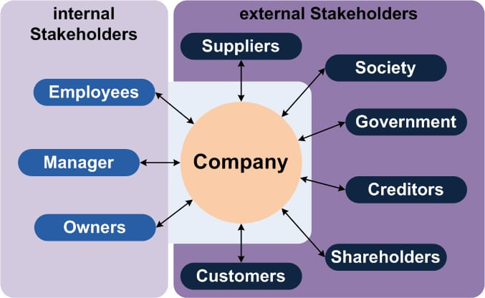
2. External Stakeholders
These are individuals, groups or organizations indirectly involved but who may influence or be affected by the facility.
Government and Regulatory Bodies
Customers and Clients
Suppliers and Service Providers
Local Community
Financial Institutions

Slide 5
3. High Influence, High Interest
Inverstors/Owners
Regulatory Bodies (e.g., FDA, Health and Safety Authorities)
Local Government

Slide 6
4. High Influence, Low Interest
Board of Directors
Environmental Agencies
Financial Institutions

Slide 7
Summary of Influence/Interest Grid
Category | Examples | Influence | Interest
High Influence, High Interest | Investors, Regulatory Bodies | High | High
High Influence, Low Interest | Board of Directors, Environmental Bodies | High | Low
Low Influence, High Interest | Farmers, Employees | Low | High
Low Influence, Low Interest | Local Community, NGOs | Low | Low

Slide 8
TEAM MEMBERS
Y. DURGA PRASAD
V. PRANAY KUMAR
G. ABHILASH
P. SAI
P.G. VISHWA TEJA

